Slide 1

Physician Networks
Abhilash Reddy Chennreddy
Nachiket Kore
Srujan Kadanur Viswanath
Physician Network
A Social Network of Physicians

Slide 2
Background and motivation
In the healthcare industry the most common form of a patient’s treatment journey is of the form:-
Visit to a Primary Care Physician
Referral to a specialist
Referral back to the Primary Care Physician for regular checkups and monitoring
Multiple patients are referred to and from various physicians across geographies and physician types (specialties)
This constitutes a network where the physicians are the nodes and the patients are the edges
An example of such a network is shown alongside
Analysis of such a network can help:-
Health care organizations gain insight into physician collaborations within and outside a network
Government and insurance agencies track physician compliance
Pharmaceutical companies identify potential targets for marketing
Figure 1
Notes:
Add acknowledgement for image taken from ppt
https://ssri.duke.edu/sites/ssri.duke.edu/files/pictures/BigDataPresentation.pdf

Slide 3
Objective
Understand the network structure
1
Identify the influential physicians in the network
2
Customize a marketing strategy based on physician prescription behavior
3

Slide 4
Data description
The network is created using two datasets that constitute the physician referral patterns and the demographic data of physicians
Node Frame
The Physician Compare National Downloadable File is organized at the individual eligible professional level; each line is unique at the professional/enrollment record/Group Practice/address level. Professionals with multiple Medicare enrollment records and/or single enrollments linking to multiple practice location addresses are listed on multiple lines.
Datasource: https://catalog.data.gov/dataset/physician-compare-national-downloadable-file
Edge Frame
The physician referral data linked below was provided as a response to a Freedom of Information Act (FOIA) request. These files represent the number of encounters a single beneficiary has had across physicians at intervals of 30 days.
Datasource: https://catalog.data.gov/dataset/physician-shared-patient-patterns
Key Aspects for forming a network
Medical School Name
Organization
Primary Specialization Field
Secondary Specialization Field
Hospital
Graduation Year

Slide 5
Network Statistics
Attribute | Value
Nodes in network | 4487
Edges in network | 99485
Average Local Clustering | 0.230303
Assortativity of giant component | -0.2073602
Overall Clustering Coefficient | 0.3490625
Average Degree centrality of giant cluster | 46
Nodes in giant cluster | 4297
Edges in giant cluster | 99231
Communities in Giant Cluster | 30

Slide 6
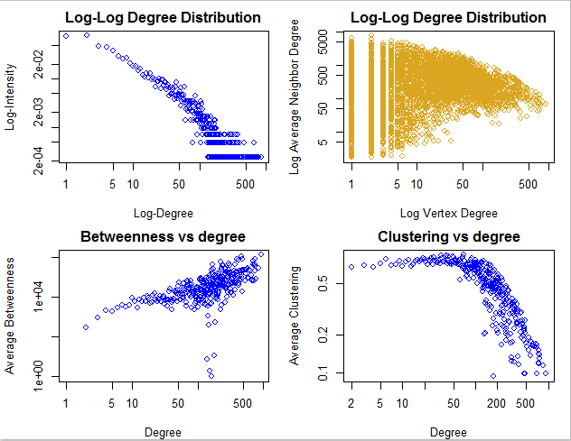
Network structure
The log-log degree distribution shows that we have a scale free n/w with that the popular physicians within the network associated with other popular individuals only. On the other hand, physicians with lower degree tend to link with physicians of both lower and higher degrees.
Graphs 3 and 4 also indicate that there are some physicians which receive a lot of referrals that serve as a link between disconnected individuals/communities (KOLs). This is a case of structural holes in the graph

Slide 7
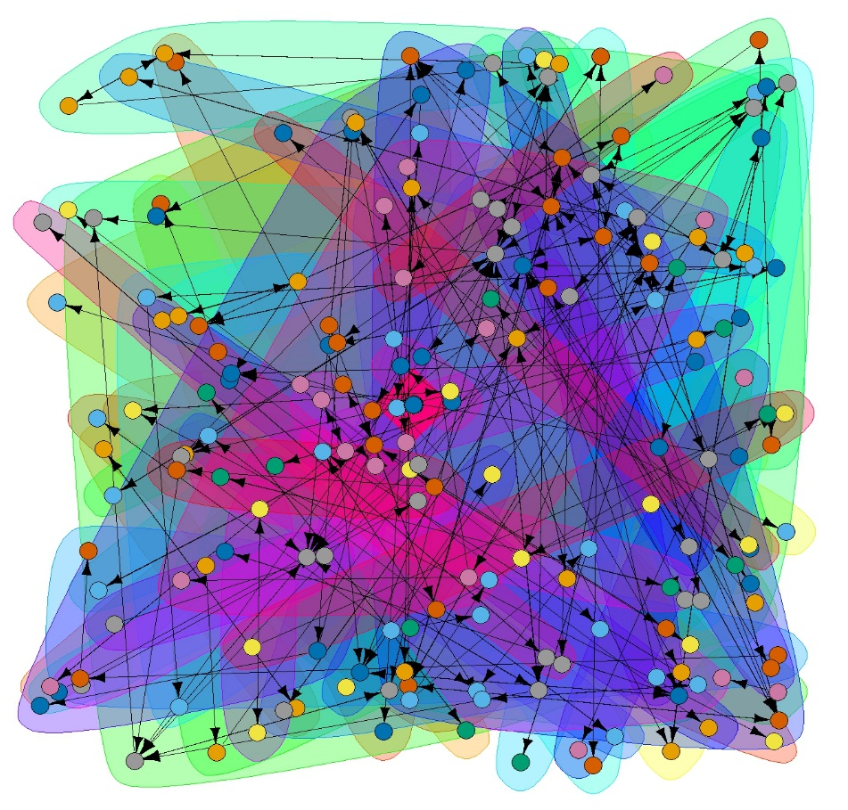
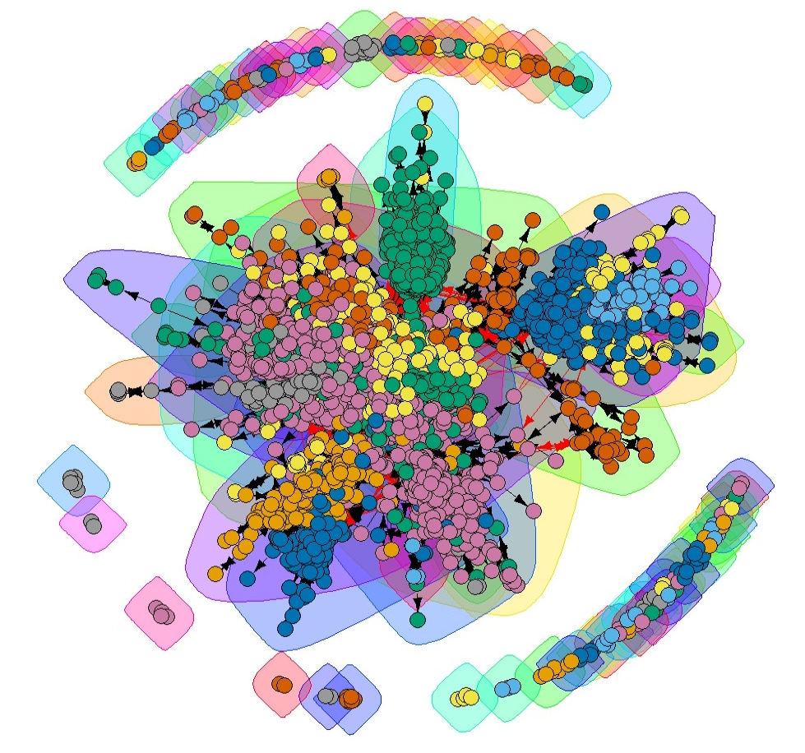
Network Graphs
Large graph layout
Fruchterman Reingold layout
Figure 2 represents the physicians network with large graph layout and Figure 3 is plotted with FR layout.
This is a network of physicians connected by shared patients in a span of 30 days where edge weights are proportional to the number of patients shared.
The above network has a total of 95 communites with gaint cluster made up of ~4500 nodes.
reflects collaboration, coordination, communication channels, diffusion of information

Slide 8
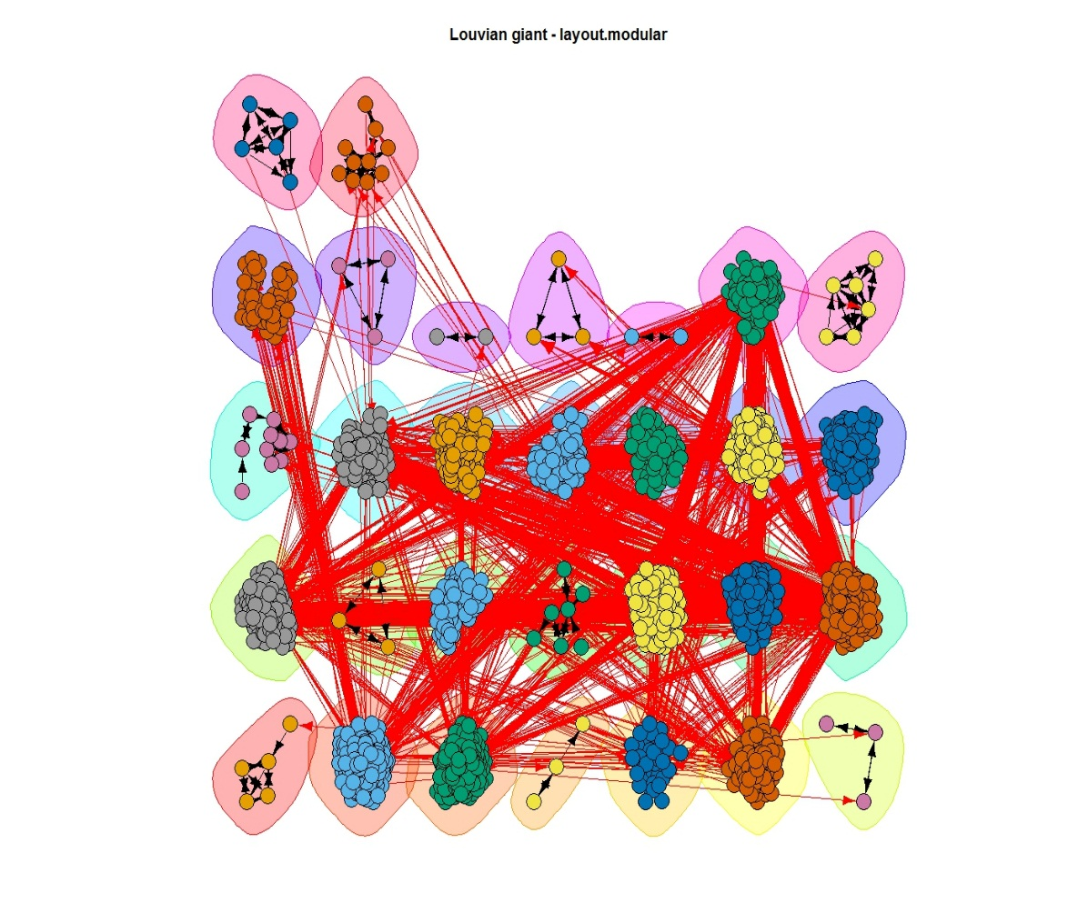
Network Graphs Continued
Figure
The image above represents the giant component in the form of separated communities where the red lines represent the edges across communities
This comprises of 30 communities connected to each other. Commumities with fewer than 13 nodes from the previous graph are separated and analyzed seperately

Slide 9
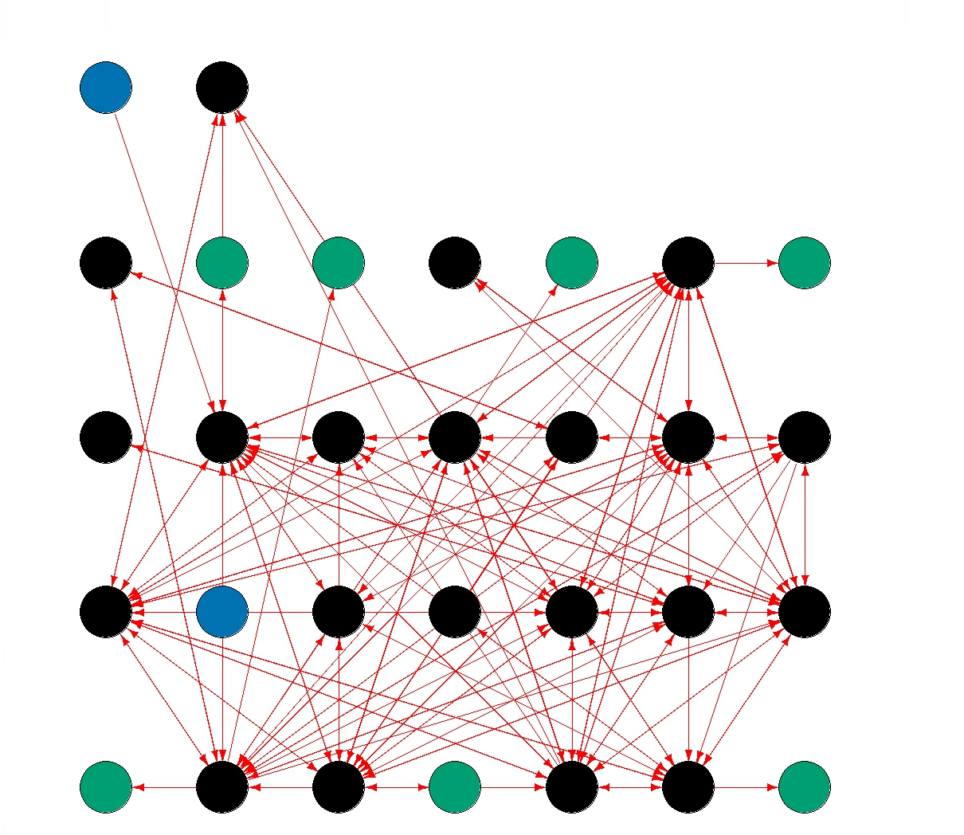
Network Graphs Continued
This represents the network with each community represented as a single node
Three types of communities are observed:-
Communities with outgoing edges only (blue)
Communities with incoming edges only ( green)
Communities with a large number of incoming and outgoing edges (black)
The communities highlighted in blue and green exhibit such a behavior because they have very few nodes in them (<10)

Slide 10
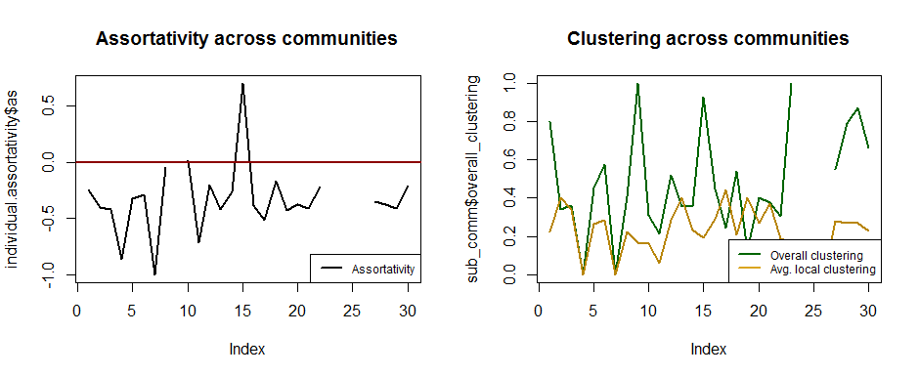
Analyzing individual communities -2
Most of the communities have negative assortativity indicating a hub and spoke structure. Thus the communities are mimicking the structure of the overall network
A trend of high overall clustering coefficient and low average local clustering indicates that localised components in the network that are sparsely connected whereas the overall structure of the communities seems to be clustered together
The missing data points in the charts correspond to communities that contain only 2 nodes

Slide 11
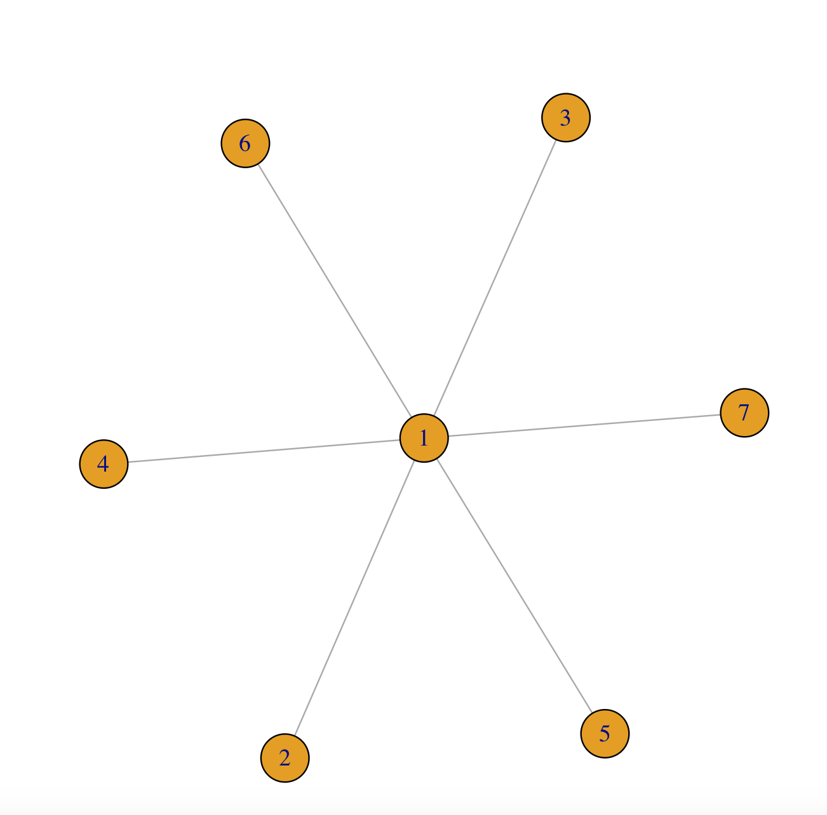
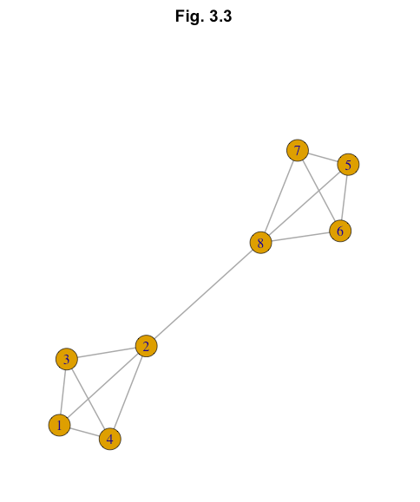
Influential physicians/communities and marketing campaign design
Traditional marketing strategies are based on modeling sales values against physician attributes. These strategies answer the question: ‘What do our customers like/dislike?’ but do not look into inter physician relations
By analyzing physician networks we can identify influential physicians and target them accordingly:-
KOLs - high in-degree centralities, low local clustering coefficients
Physicians acting as bridges – high betweenness
Primary care physicians with high degree centralities can be targeted to establish a hold in the market
Small communities with outgoing links can be influenced to direct referrals towards those communities where we have an established hold
Small communities which have high probability of forming links with larger communities can be targeted. Such communities will either grow or be absorbed within other communities
Medium sized communities with incoming links that exhibit a small world phenomenon can be targeted accordingly
A conjoint analysis of physician attributes and centrality measures can be used to gain insight into prescription patterns (Rx) to personalize messaging strategies
Node 1 – Key Opinion Leader
Bridge between Nodes 2 and 8

Slide 12
Appendix

Slide 13
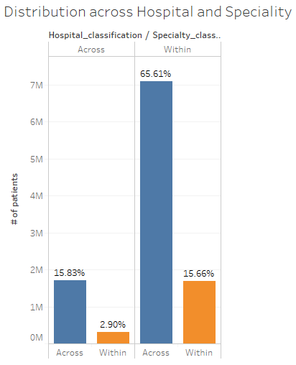
Preliminary findings
Cardiovascular diseases, Nephrology, pulmonary diseases and oncology related cases are highly referred
65.61% of the referrals are within the hospital across different specialities. These contribute the to traditional patient journey discussed earlier
This analysis consists of physicians from radiology, pathology and physical medication/rehabilitation specialties that ideally should not be considered in such an analysis
Northwest memorial, Rush hospital, University of Chicago and the Presence ressurction medical centre have the highest number of physician referrals to and from them

Slide 14
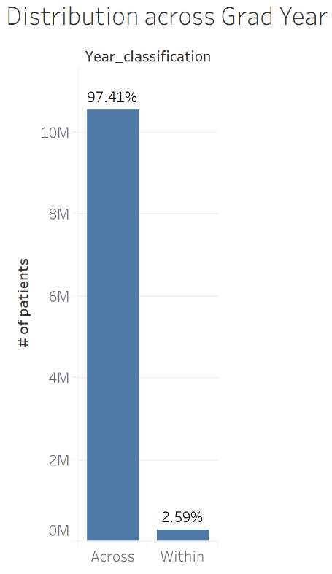
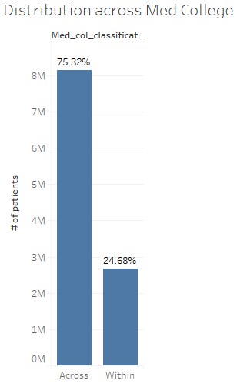
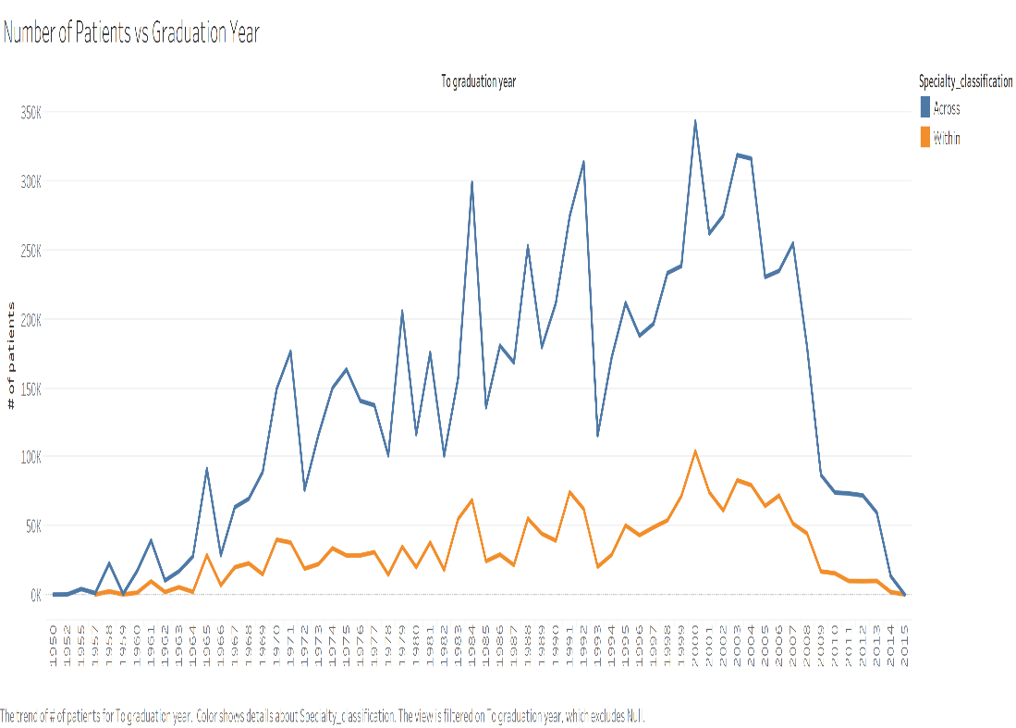
Preliminary findings continued
Only 2.59% of the total referrals referred specialists graduated in the same year
24.68% of the total physicians referred to other physicians from the same medical college
A gradual increase and decrease with a peak between 2000-05 is observed in the # of patients vs graduation year graph.

Slide 15
Citation
https://ssri.duke.edu/sites/ssri.duke.edu/files/pictures/BigDataPresentation.pdf
https://catalog.data.gov/dataset/physician-shared-patient-patterns
https://catalog.data.gov/dataset/physician-compare-national-downloadable-file
https://arxiv.org/pdf/1711.03245.pdf
https://ssri.duke.edu/sites/ssri.duke.edu/files/pictures/BigDataPresentation.pdf
https://strategichcmarketing.com/physician-referrals-social-network-really-matters-health-care-marketers/

